Slide 1

Computer Graphics
Scan Conversion
Lecture By:
Md. Manirujjaman
Lecturer
Dept. of CSE, DIU
Contact: 01772430221
Mail: manirujjaman25803690@gmail.com
Text Book Reference:
Computer Graphics 2nd Edition, Zhigang Xiang and Roy Plastock (2004) (chapter -03)
Slide originally created by Shuvo Sir (KUET CSE) . Modified by Md. Manirujjaman

Slide 2
Output Primitives
Basic geometric structures used to describe scenes.
Can be grouped into more complex structures.
Each one is specified with input coordinate data and other information about the way that object is to be displayed.
Examples: point, line and circle each one with specified coordinates.
Construct the vector picture.

Slide 3
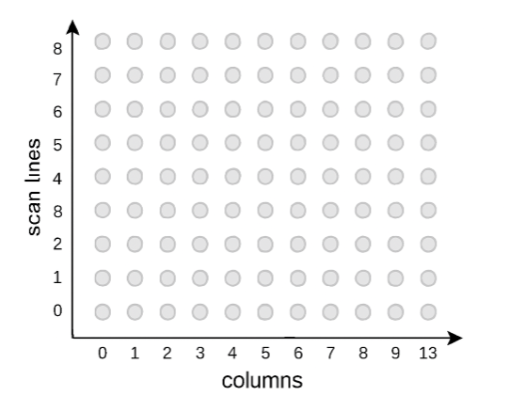
Digital Representation
Display screen is divided into scan lines and columns.
Pixels positions are referenced according to scan line number and column number (columns across scan lines).
  Scan lines start from 0 at screen bottom, and columns start from 0 at the screen left side.
Screen locations (or pixels) are referenced with integer values.
The frame buffer stores the intensities temporarily.
Video controller reads from the frame buffer and plots the screen pixels.

Slide 4
Digital Representation(cont.)
A line segment in a scene is defined by the coordinate positions of the line end-points.
y
(7, 5)
(2, 2)
x

Slide 5
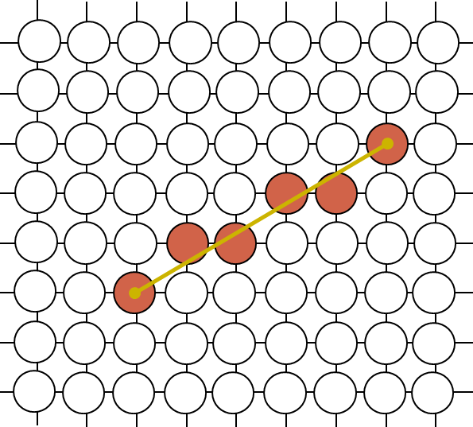
Digital Representation(cont.)
But what happens when we try to draw this on a pixel based display?
How do we choose which pixels to turn on?

Slide 6
Scan Conversion
The process of representing continuous graphics object as a collection of discrete pixels is called Scan Conversion.
For e.g a line is defined by its two end points & the line equation, where as a circle is defined by its radius, center position & circle equation.
It is the responsibility of graphics system or the application program to convert each primitive from its geometric definition into a set of pixels that make up the primitive in image space. This conversion task is generally referred to as a scan conversion or rasterization.

Slide 7
Scan Conversion(cont.)
How It Works in Practice
Define the primitive: e.g., a line from (2,3) to (7,8).
Apply scan conversion algorithm: Determine which pixels best approximate the shape.
Store pixel data in frame buffer: Each pixel gets intensity/color info.
Video controller reads buffer: It plots the pixels on screen row by row.

Slide 8
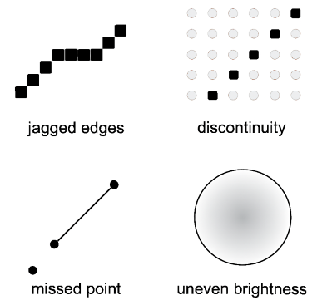
Scan Conversion(cont.)
Drawing lines, circles, and etc. on a grid implicitly involves approximation.
Ideally, the following properties should be considered
  smooth
  continuous
  pass through specified points
  uniform brightness
  efficient

Slide 9
Scan Converting a Point
A mathematical point (x,y) where x & y are real numbers within an image area, needs to be scan-converted to a pixel at location (x’,y’).
Can be done by making x’ & y’ to be the integer part of x & y.
  x’= Floor(x) and y’= Floor(y)
  P1(1.7,0.8) is represented by pixel (1,0)
  P2(2.2,1.3) and P3(2.8,1.9) are both represented by pixel (2,1).

Slide 10
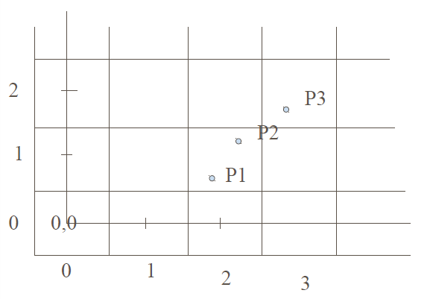
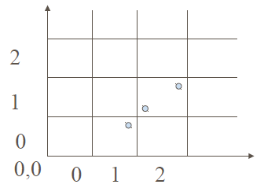
Scan Converting a Point(cont.)
Another approach is to scan convert (x,y) by making
  x’ = Floor(x + 0.5) and y’ =Floor(y+0.5).
  Points P1 and P2 are now both represented by pixel (2,1) whereas point P3 is represented by pixel (3,2).
This essentially places the origin of the coordinate system for (x,y) at the center of pixel(0,0).

Slide 11
Scan Converting a Line
A line is defined by its two end points & the slope intercept equation for a line:
  y = mx + b, m = Slope of the line, b = the y intercept of a line
Line drawing is done by:
  Calculating intermediate positions between the endpoints.
  Directing the output device to fill in the calculated positions as in the case of plotting single points.

Slide 12
Scan Converting a Line(cont.)
Plotted positions may be only approximations to the actual line positions between endpoints.
  A computed position (10.48, 20.51) is converted to pixel (10,21).
This rounding causes the lines to be displayed with a stairstep appearance.
Stairsteps are noticeable in low resolution systems, it can be improved by:
  Displaying lines on high resolution systems.
  Adjusting intensities along line path.

Slide 13
Scan Converting a Line(cont.)
The Cartesian intercept equation for a straight line:
  y= m. x +b
For line segment starting in (x1,y1) and ending in (x2,y2), the slop is:
  m= (y1-y2)/(x1-x2)
  b= y1- m.x1
For any given x interval Δx, we can compute the corresponding y interval Δy:
  Δy= m . Δx
Or x interval Δx from a given Δy:
  Δx= Δy/m

Slide 14
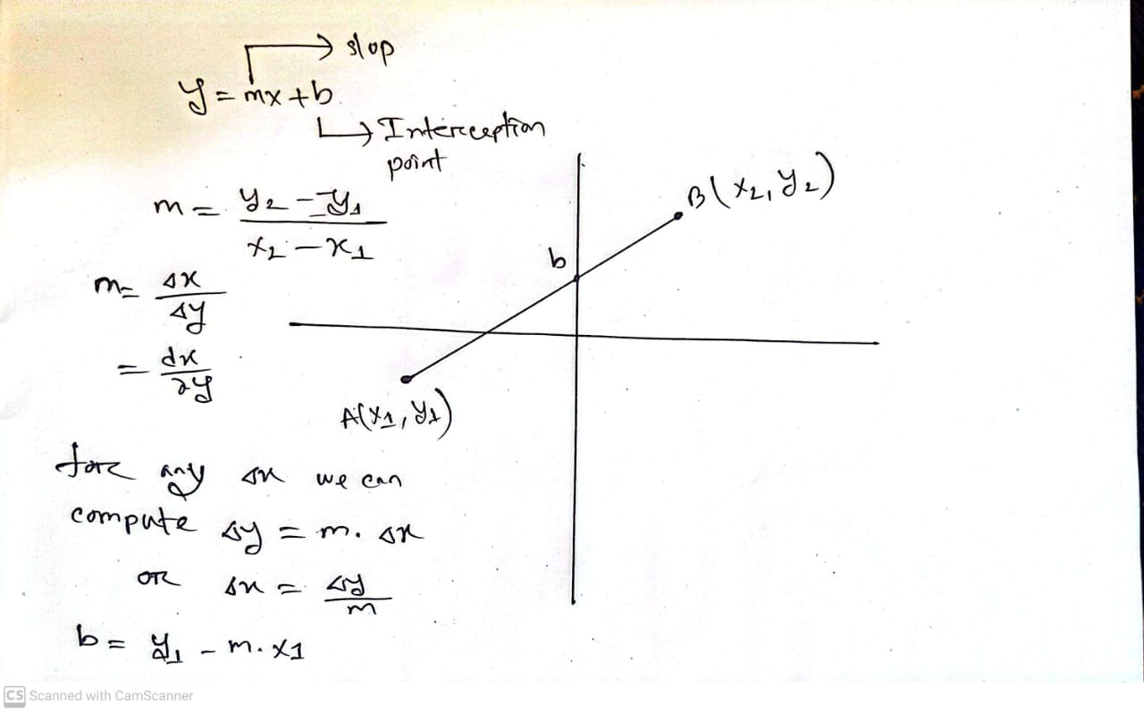
Scan Converting a Line(cont.)

Slide 15
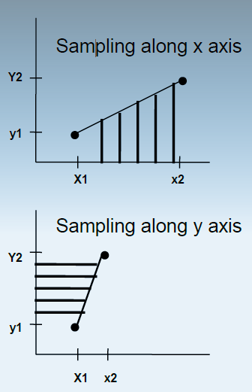
Scan Converting a Line(cont.)
On raster systems, lines are plotted with pixels, and step sizes in the horizontal and vertical directions are constrained by pixel separations.
Scan conversion process samples a line at discrete positions and determine the nearest pixel to the line at each sampled position. (Incremental Fashion)

Slide 16
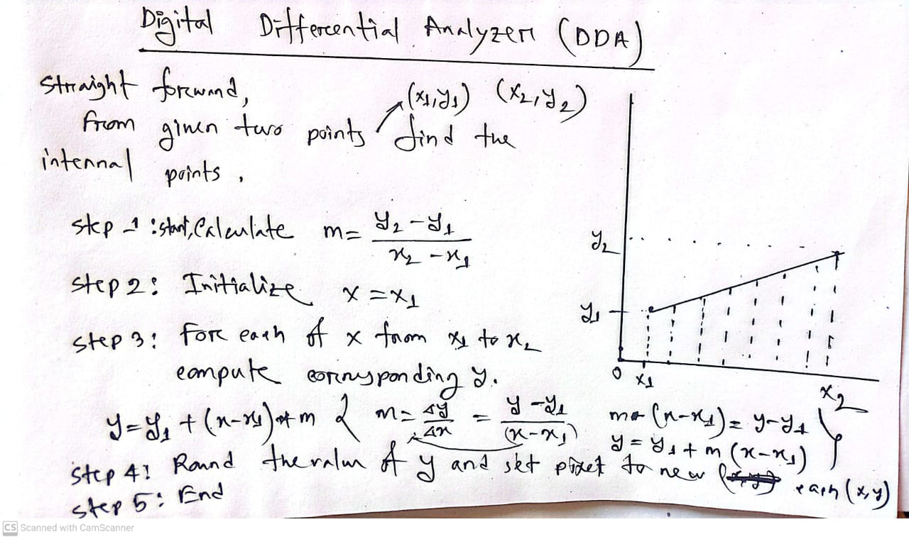
Scan Converting a Line(cont.)

Slide 17
Line Drawing - Algorithm 1
A Straightforward Implementation
DrawLine(int x1,int y1, int x2,int y2, int color)
{
float y;
int x;
for (x=x1; x<=x2; x++)
{
y = y1 + (x-x1)*m
WritePixel(x, Round(y), color );
}
}

Slide 18
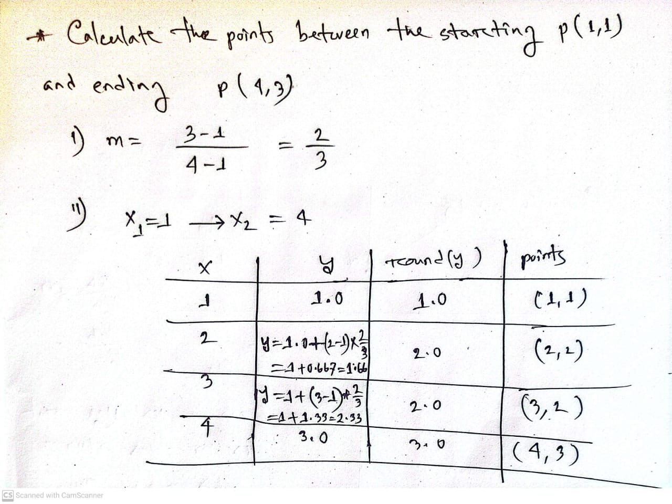
Scan Converting a Line(cont.)

Slide 19
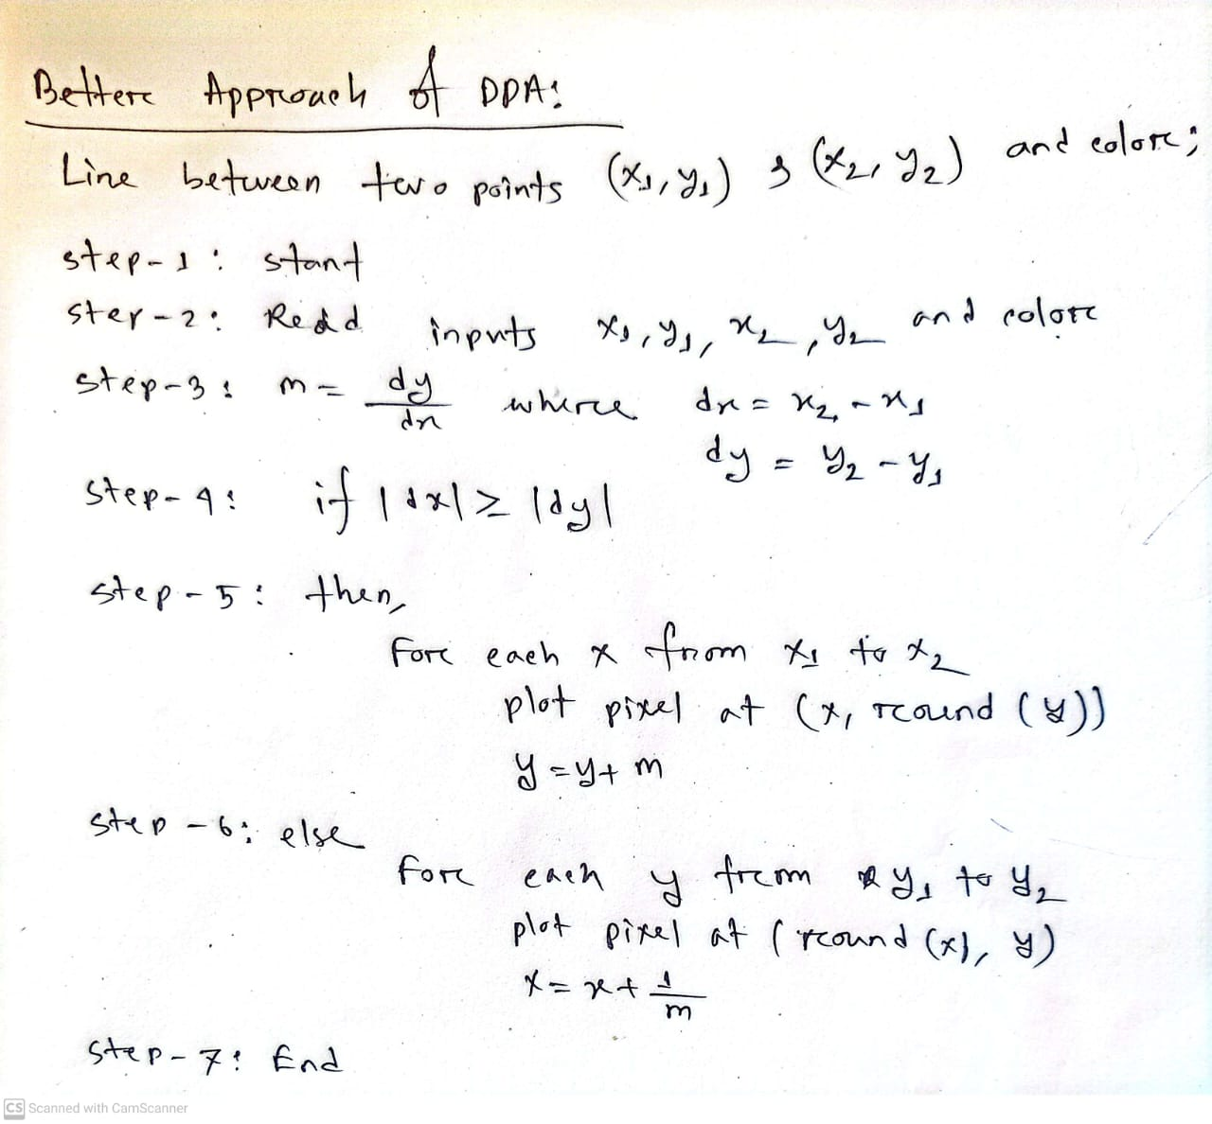
Scan Converting a Line(cont.)

Slide 20
Line Drawing - Algorithm 2
A Better Implementation
DrawLine(int x1,int y1,int x2,int y2, int color)
{
float m,y;
int dx,dy,x;
dx = x2 - x1; dy = y2 - y1; m = dy/dx;
if (dx>=dy){
for (x=x1; x<=x2; x++)
{
WritePixel(x, Round(y), color );
y = y + m;
}}
else {for (y=y1; y<=y2; y++)
{
WritePixel(Round(x),y, color );
x = x + 1/m;
}}
}

Slide 21
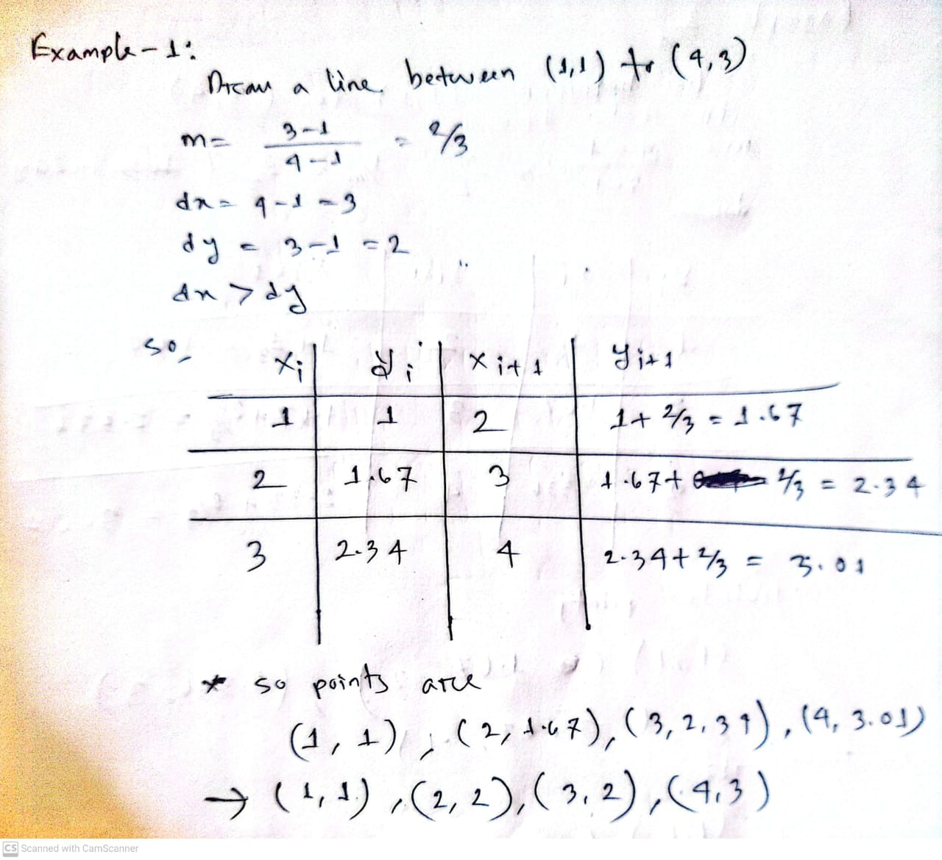
Scan Converting a Line(cont.)

Slide 22
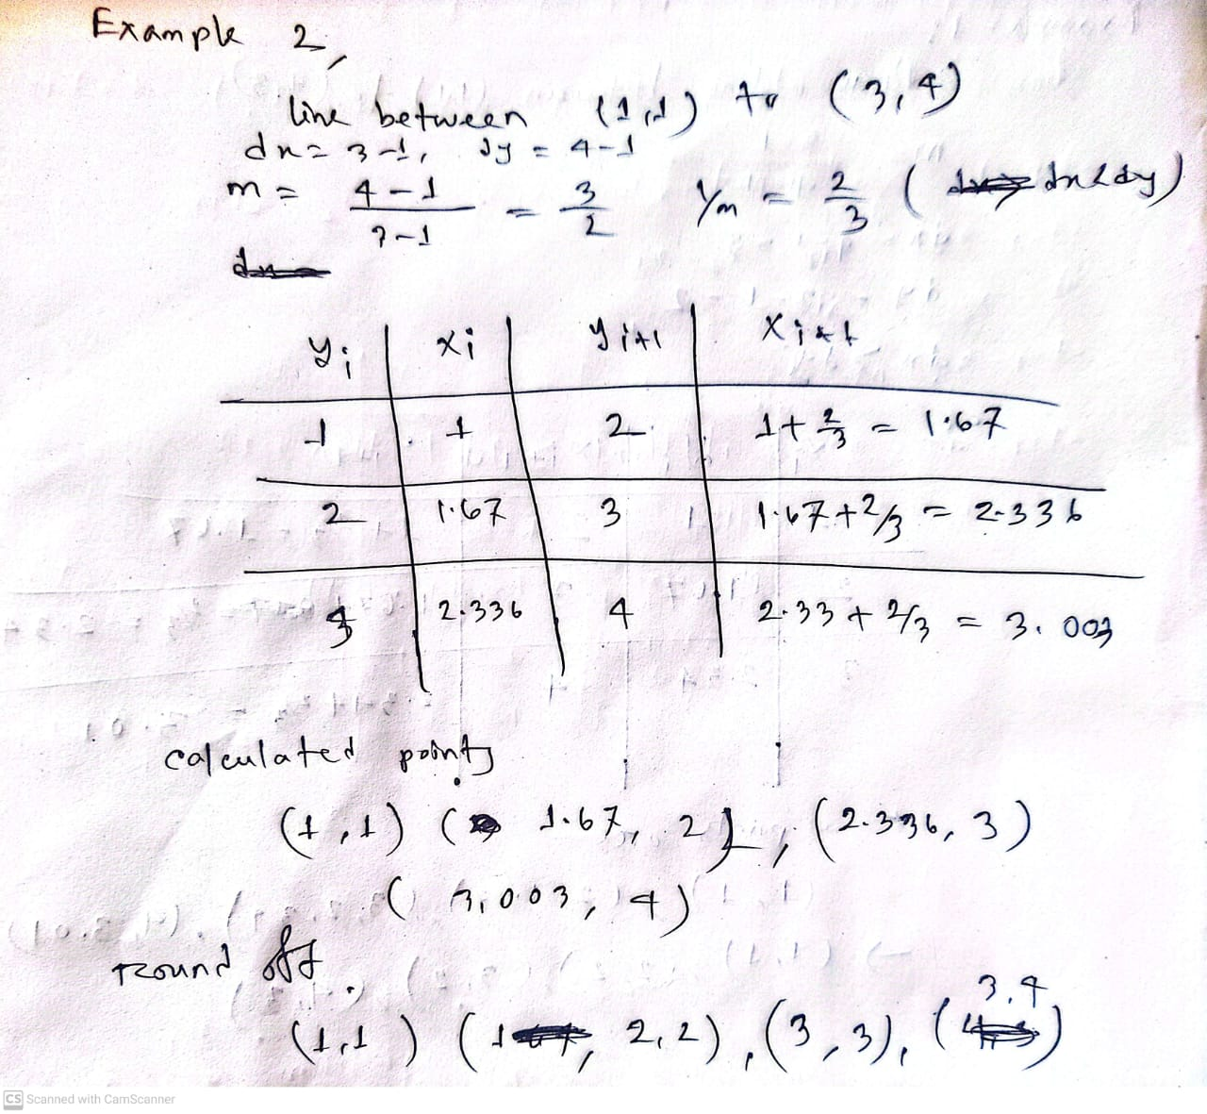
Scan Converting a Line(cont.)

Slide 23
Line Drawing Algorithm Comparison
Advantages over Algorithm 1
  eliminates multiplication
  improves speed
Disadvantages
  round-off error builds up
    get pixel drift
  rounding and floating point arithmetic still time consuming
  works well only for |m| < 1
  need to loop in y for |m| > 1
  need to handle special cases

